Slide 1

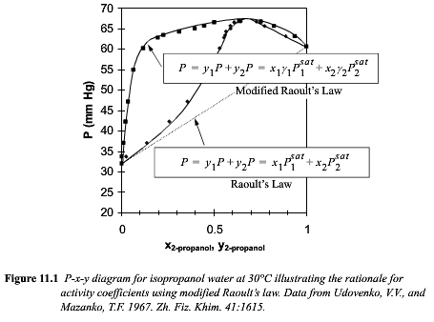

Slide 2
Boltzmann Probability of a Thermally Reversible Event = exp(-ΔS/kT)
ΔS is the change in entropy for the event (Ω is number of choices, for one choice p₁ = 1/Ω)
ΔG = ΔH – TΔS (Const. T & P, e.g. an experimental measurement)
ΔA = ΔU – TΔS (Const. T & V, e.g. a simulation on a grid)
Consider an ideal gas with no enthalpic interactions, ΔH = 0 (or ΔU = 0 )
The probability of finding an atom A in a mixture of A and B is the molar concentration x_{A}
ΔS_{A}/k = -ln x_{A} from the Boltzmann probability
and
ΔS/k = - x_{A}ln x_{A} - x_{B}ln x_{B} by a rule of random mixtures
ΔG_{ideal}/kT = x_{A}ln x_{A} + x_{B}ln x_{B} this is always negative since “ln” of a number less than 1 is negative, so mixing always reduces the free energy so it always occurs for an ideal mixture
Hildebrandt Real Solution model considers binary interactions.
The probability of a binary interaction of A and B is x_{A}x_{B}, probability of finding A and B
This interaction has an average enthalpy (or ΔU + PV) ΔH/kT = x_{A}x_{B} Ω_{AB} or x₁x₁Α₁₂
Where the first term is the Hildebrandt binary interaction parameter and the second is the Margules one-parameter interaction term. For polymers χ₁₂ is used, the Flory –Huggins interaction parameter (with a few modifications).
ΔG_{real solution}/kT = x₁ln x₁ + x₂ln x₂ + x₁x₁ Α₁₂ = x₁ln a₁ + x₂ln a₂ = x₁ln γ₁x₁ + x₂ln γ₂x₂
ΔH/kT = ΔG_{excess}/kT = x₁x₁ Α₁₂ = x₁ln γ₁ + x₂ln γ₂ Α₁₂ is linear in (1/T)

Slide 3





intrinsic
Excess free energy per mole
G^{E} is the excess free energy value, so nG^{E}
The excess chemical potential of component “i” in phase L or V, μ_{i}^{E} is given by
extrinsic
partial molar
This is how you can find the activity coefficients from the Margules one-parameter coefficient (or the Hildebrandt or Flory-Huggins interaction parameters)

Slide 4





















Slide 5











Redlich-Kister Model

Slide 6


When x₂ ~ 1 γ₂ ~ 1 lnx₂γ₂ ~ 0
Π = dΔG^{mix}/dc

Slide 7


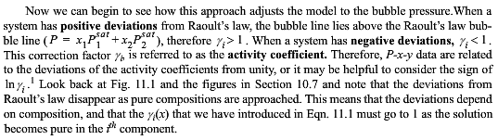
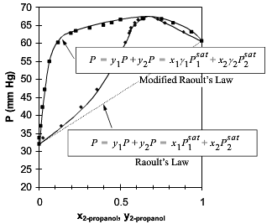
lnγ₁ = A₁₂x₂²

Slide 8


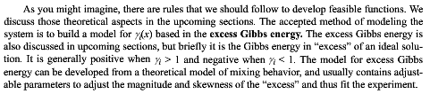
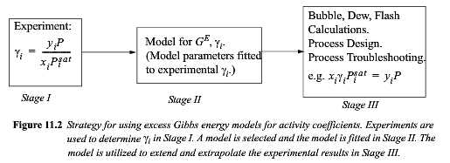
lnγ₁ = A₁₂x₂²

Slide 9


Slide 10
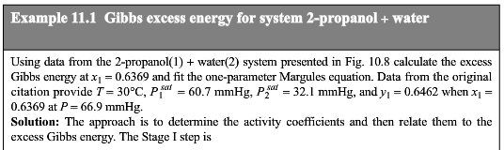
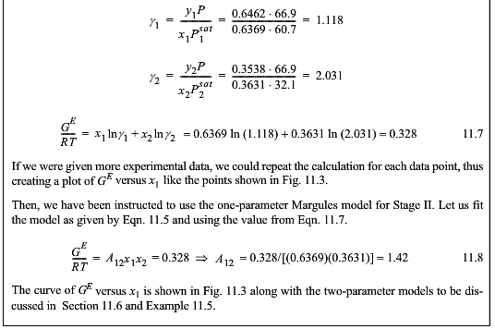

Slide 11
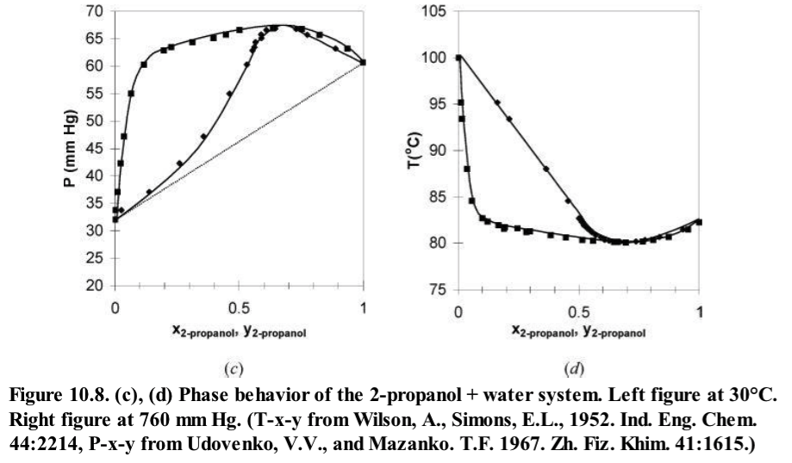

Slide 12


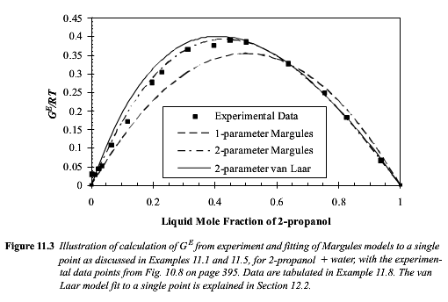

Slide 14

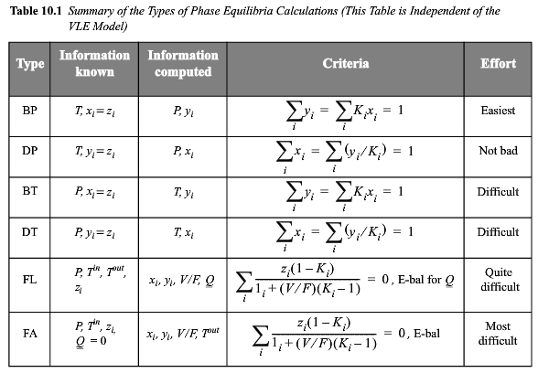
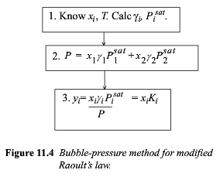

Slide 15
intrinsic
extrinsic
partial molar

Slide 16
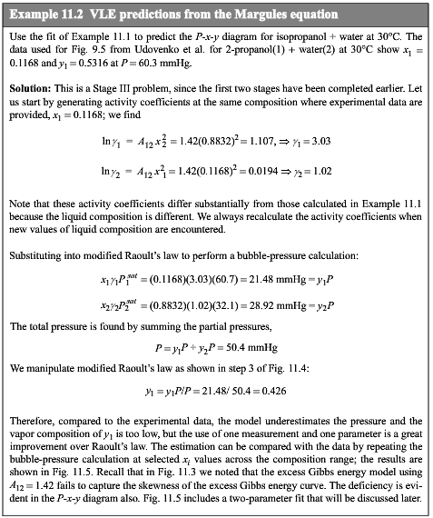

Slide 17
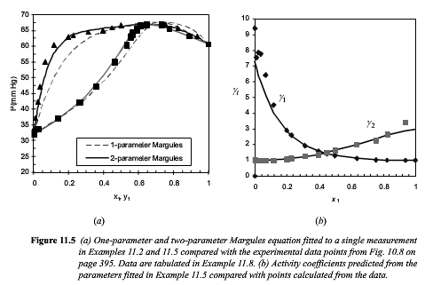

Slide 18
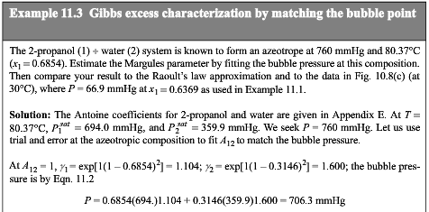


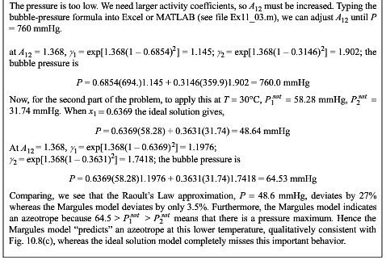

Slide 19
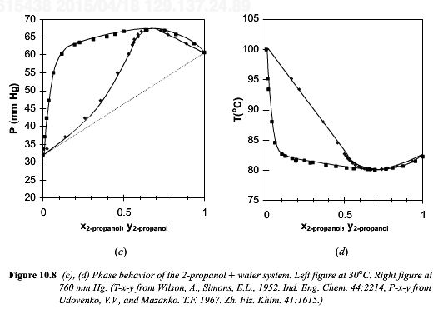

Slide 20
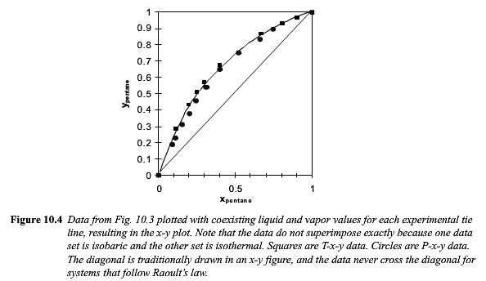
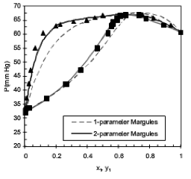
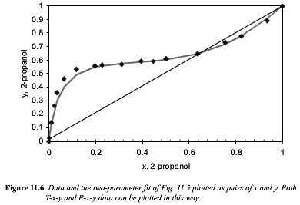

Slide 21
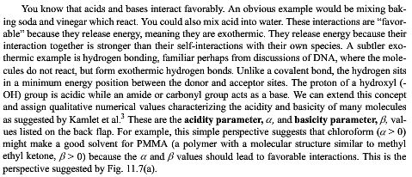
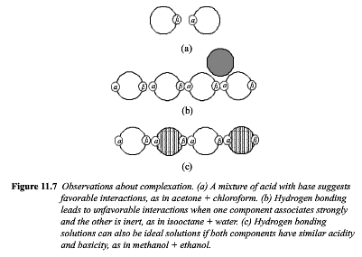


Slide 22


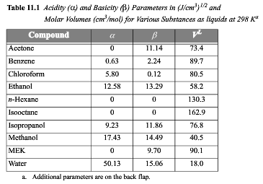

Slide 23
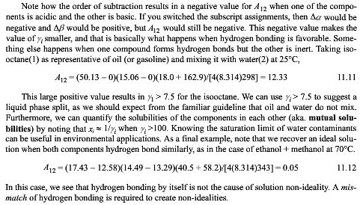

Slide 24
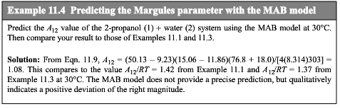

Slide 25
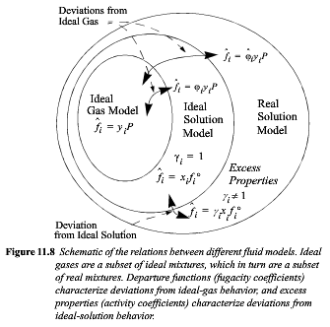

Slide 26









Slide 27

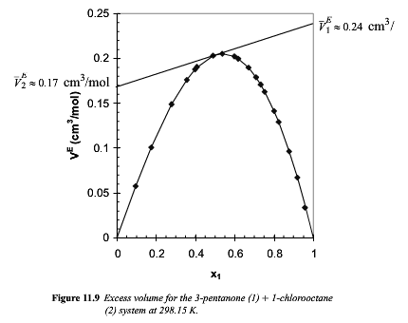

Slide 28


Slide 29

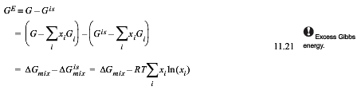




Slide 30
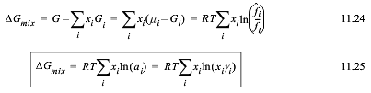
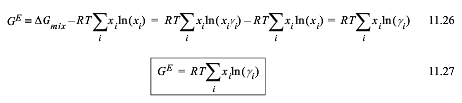




Slide 32



Slide 33

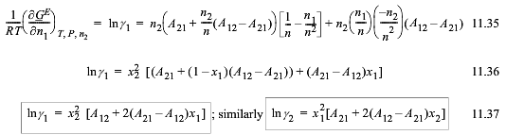


Slide 34
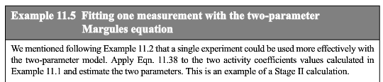
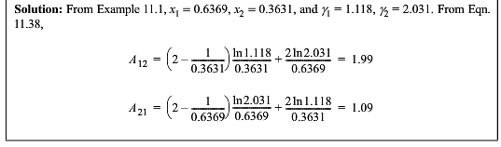

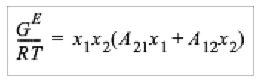

Slide 35
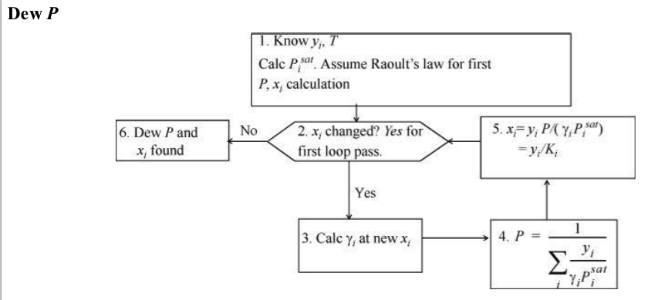
Appendix C pp. 833

Slide 36

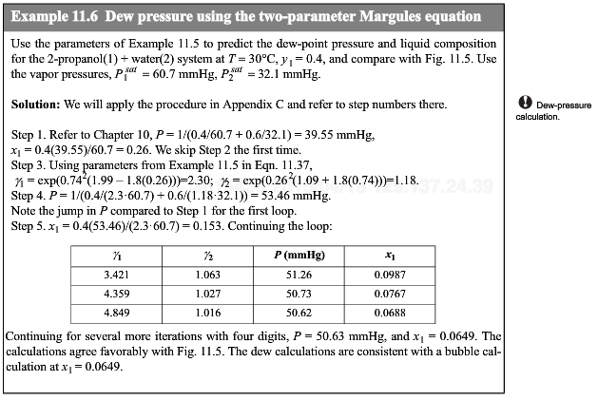



Slide 38
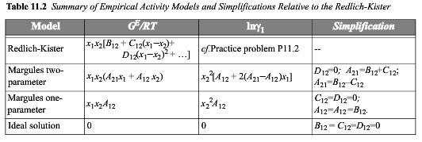

Slide 39


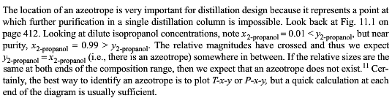

Slide 40
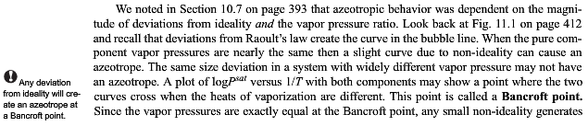
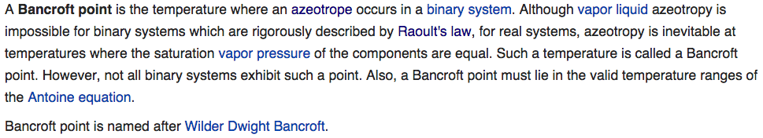
Could find an Azeotrope by setting Antoine eqn for two components equal and solving for the temperature (must be in the range of the AE).

Slide 41
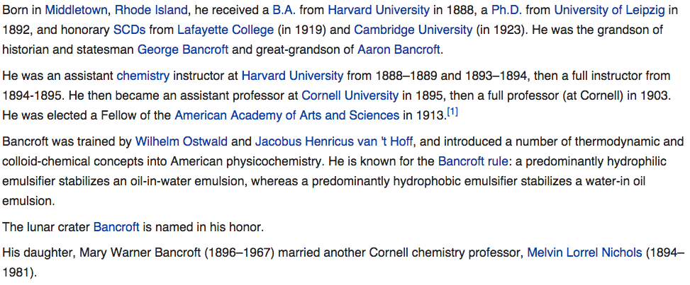

Slide 42
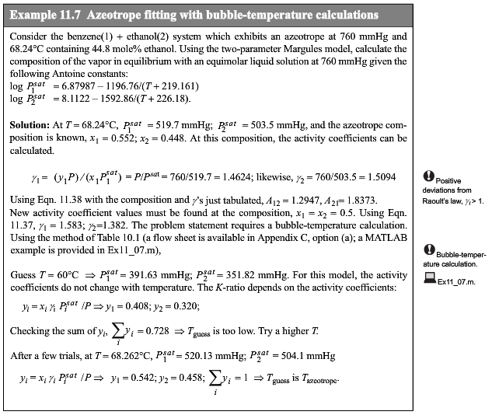



Slide 43

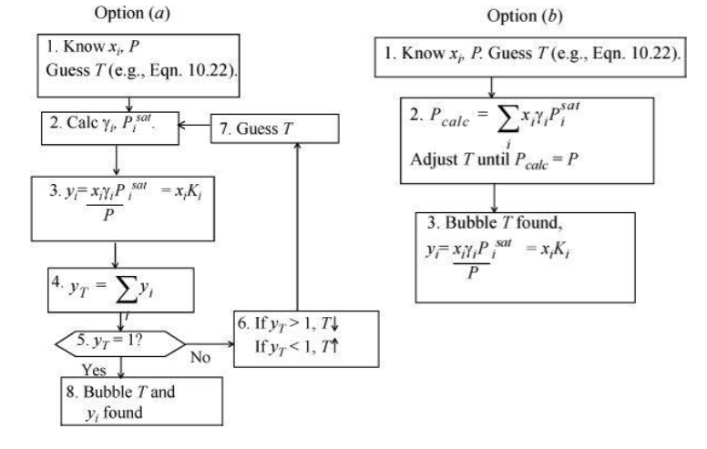
Appendix C pp. 832

Slide 44


Slide 45
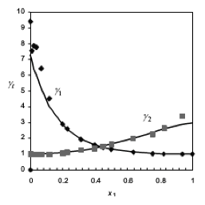

Slide 46

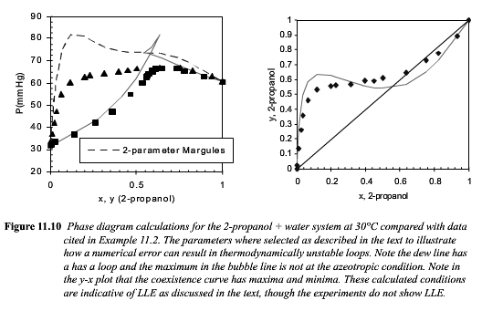
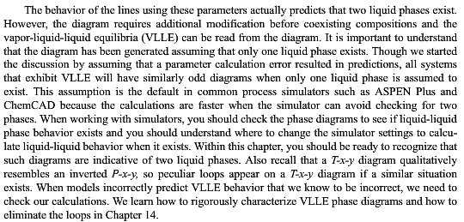

Slide 47
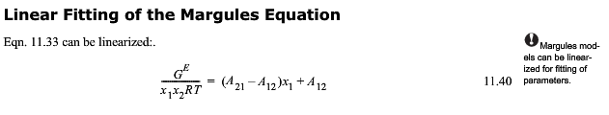



Slide 48
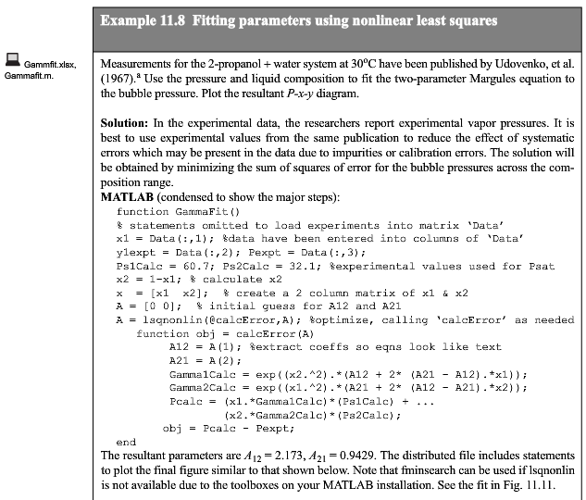

Slide 49
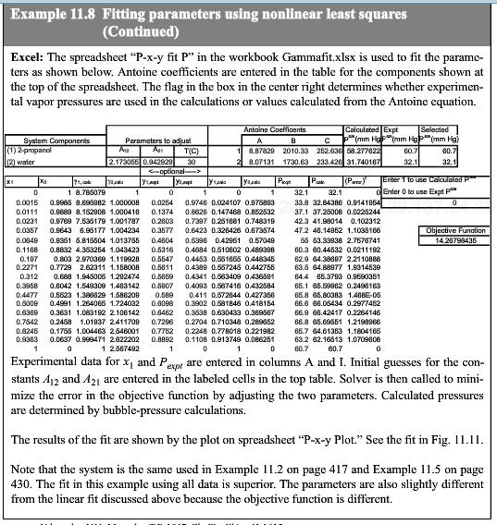

Slide 50
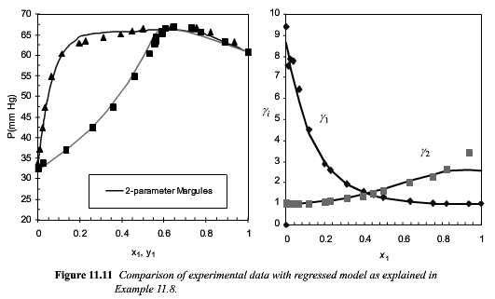

Slide 51


Slide 52




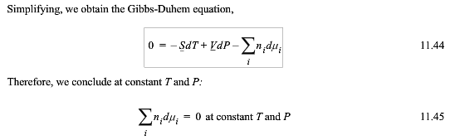

Slide 53



Slide 54


Slide 55




Slide 56




Slide 57


Slide 58




Slide 59

Henry’s Law and Raoult’s Law (Wikipedia)

Slide 60

Henry’s Law and Raoult’s Law
HW Problem 10.8

Slide 61





Slide 62


Slide 63

Gamma i star is at infinite dilution

Slide 64


Slide 65




Because it follows LR here

Slide 66


Slide 67



Slide 68


Slide 69




Slide 70



Slide 71



Slide 72


Slide 73




Slide 74


Slide 75


Slide 76



Slide 77




Slide 78




Slide 79



